Slide 1
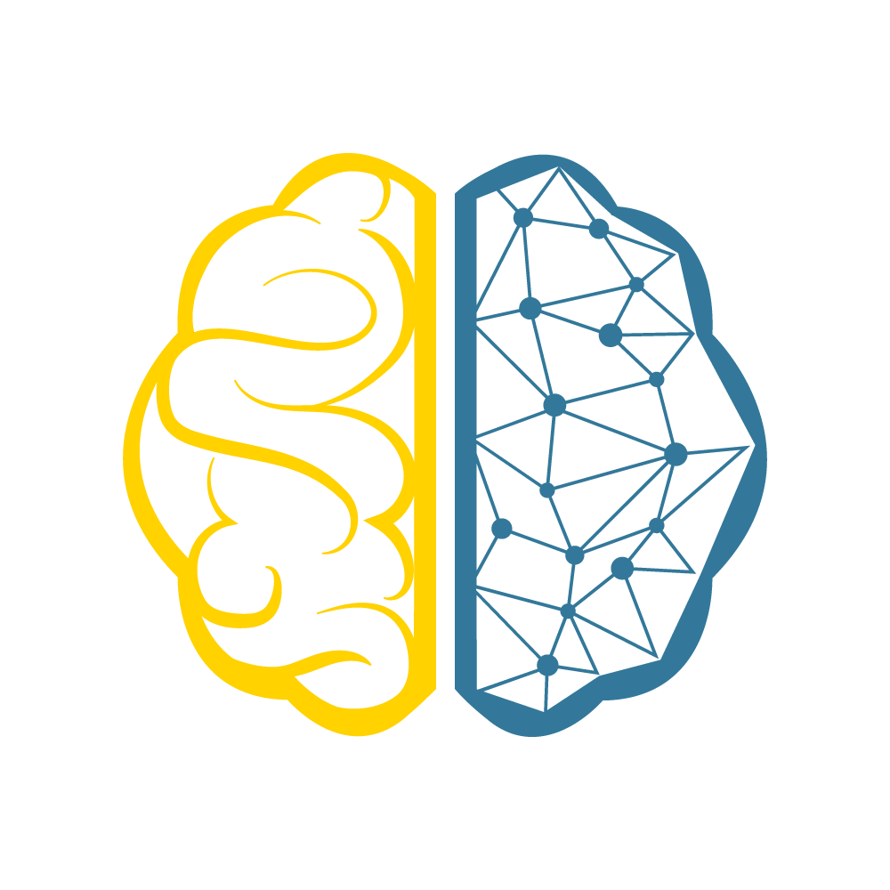
Introduction to TensorFlow

Slide 2
Pre-requisites
High-level understanding of ML/DL
If you plan on coding along:
Understanding of Python

Slide 3
Goals
Understanding of TensorFlow, Autodifferentiation
Building, Training, & Visualizing Neural Nets with TensorFlow
Developing production quality Neural Net models
Integrating Tensorflow into your application stack

Slide 4
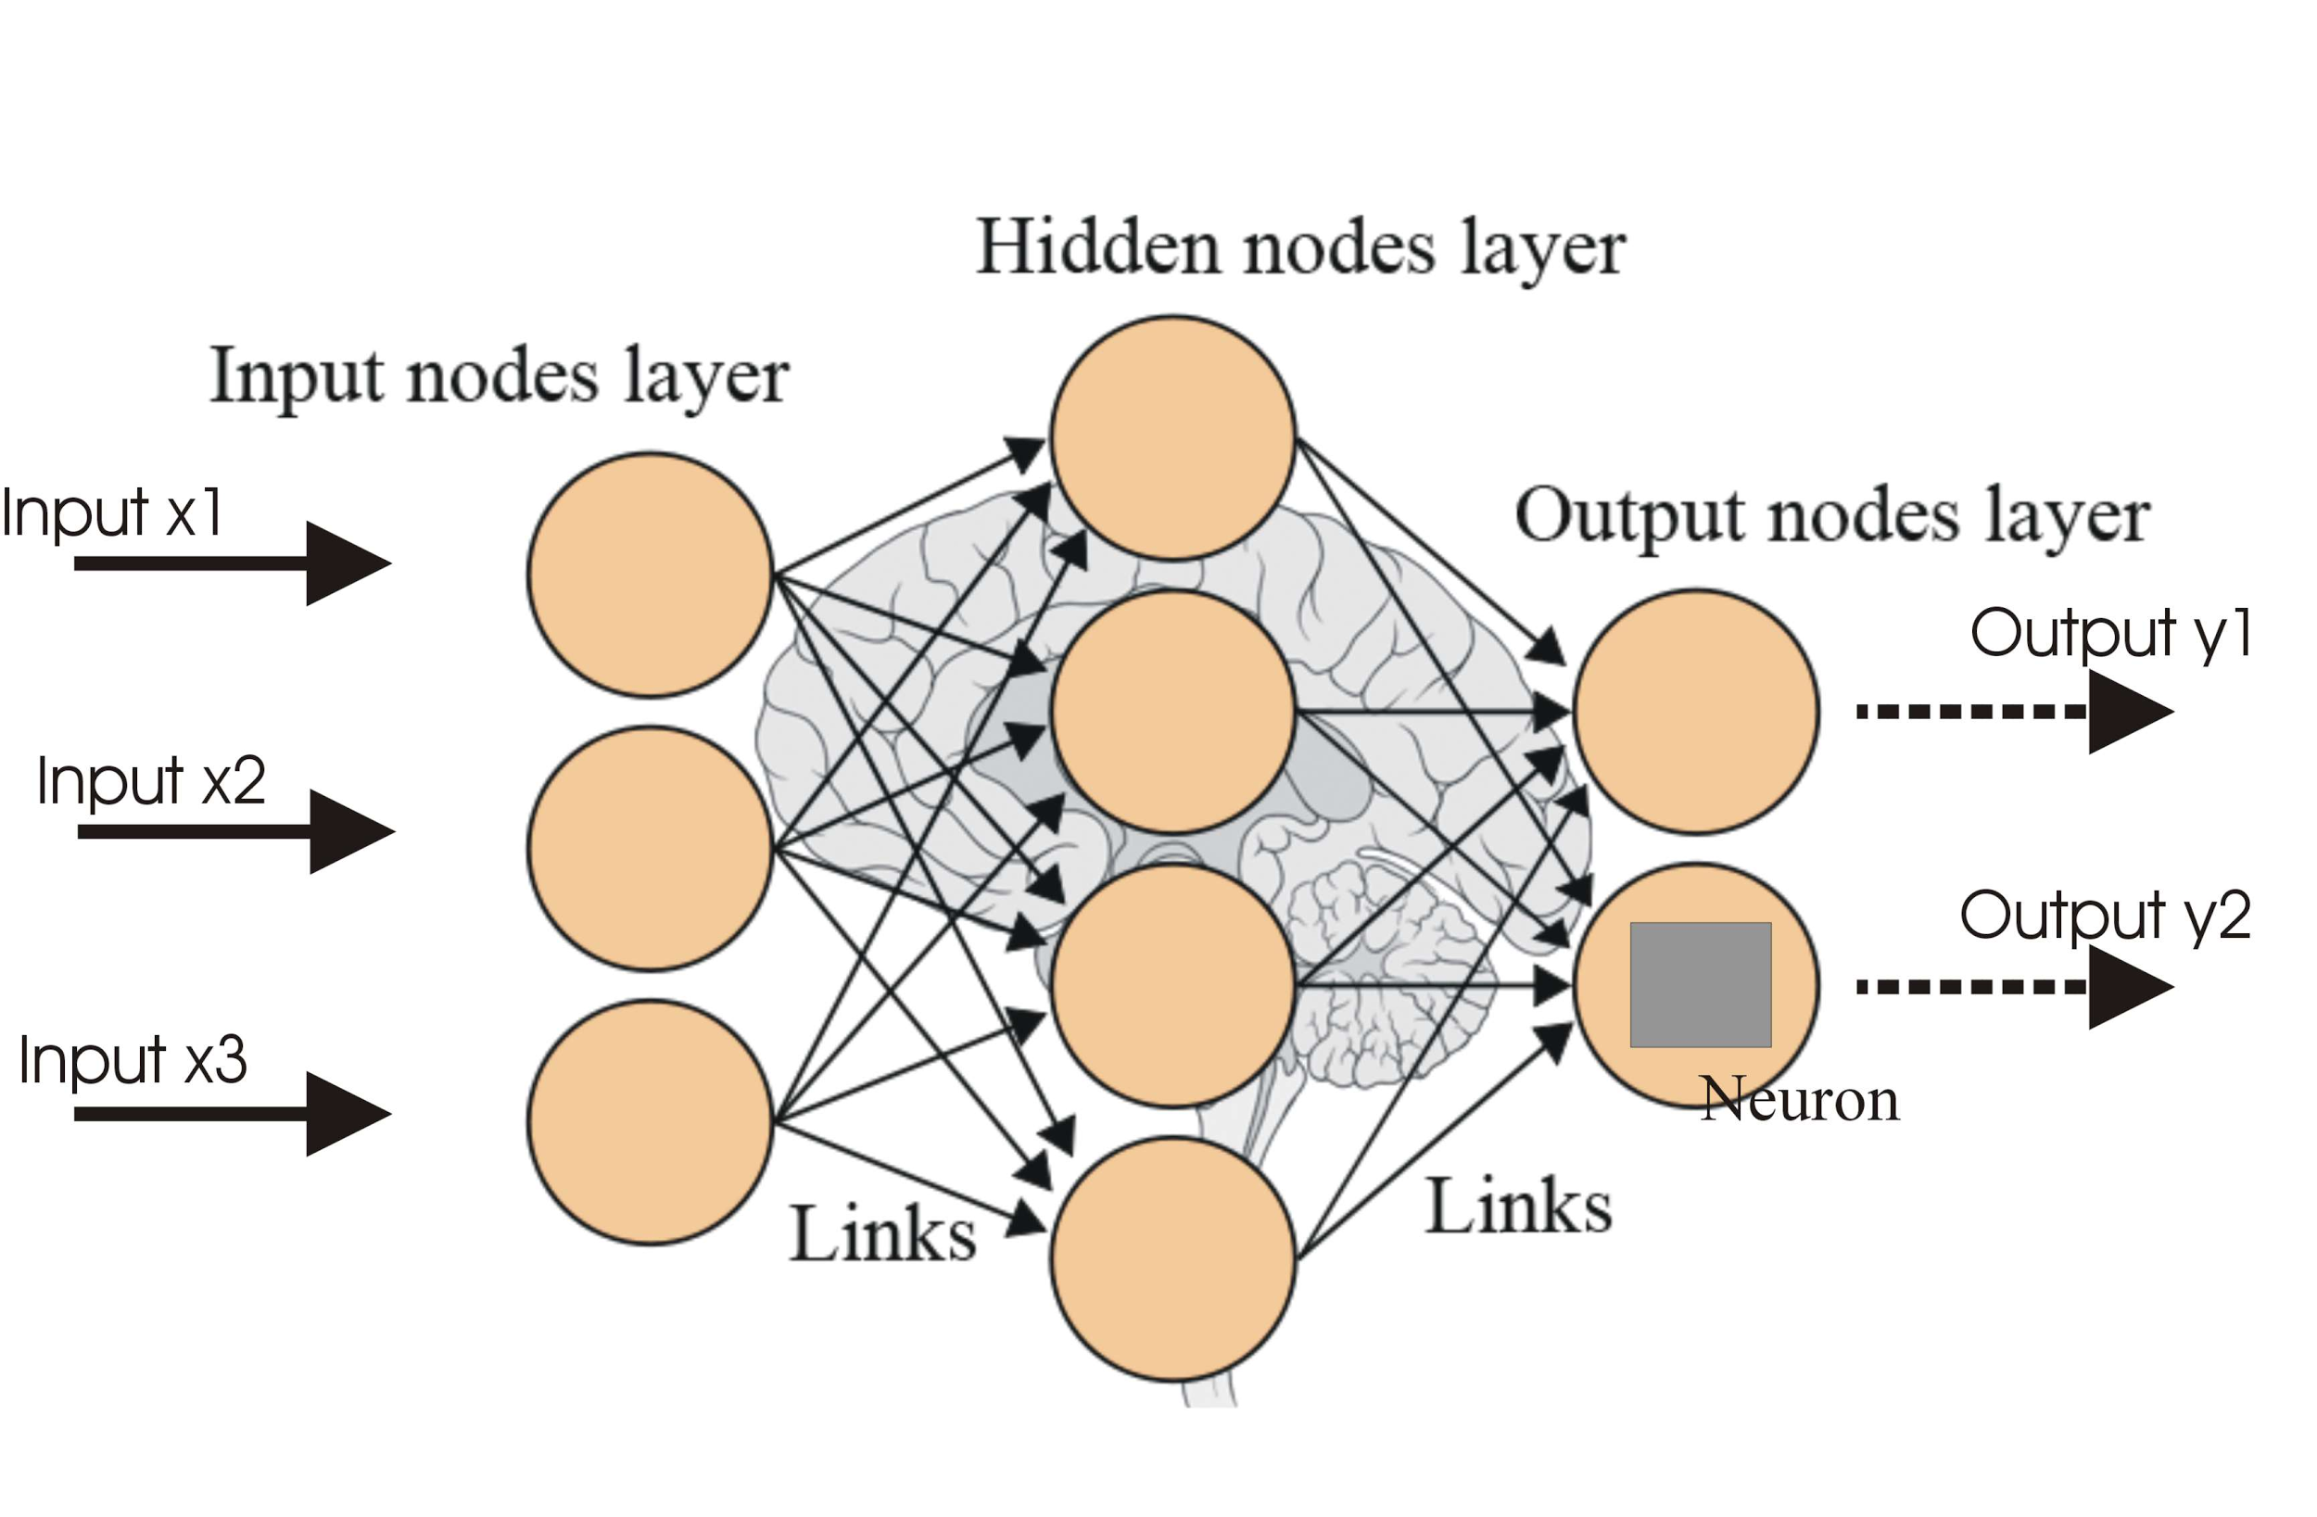
NN Review - Defining NNs
NNs are simplified models of neural processing in the brain

Slide 5
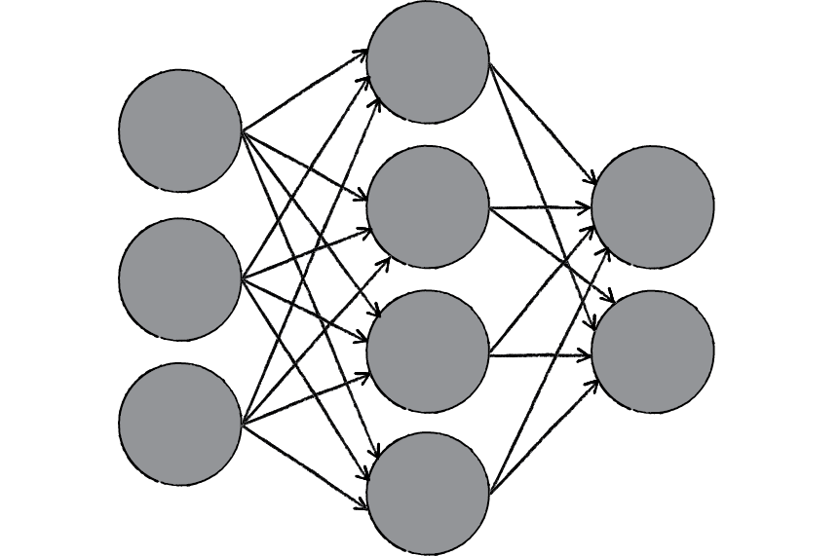
Neural Networks Review
Layers that combine previous features to form new features
Each layer applies linear transformation, “weighing” previous features
Nonlinear activation function
Learns through gradient descent and backpropagation
BACKPROPAGATE
FEEDFORWARD

Slide 6
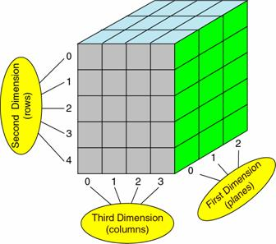
Tensors
Programmers: Tensors generalize multidimensional arrays.
Mathematicians: Generalize scalars, vectors, matrices and linear operators!

Slide 7
Computation Graph
tf.random_normal
(mean=1, stddev=2)
tf.constant(3.0)
tf.mul()
tf.add()
tf.constant(5.0)

Slide 8
NNs+Data
NNs are data driven models
More data->better results
Universal Function Approximator
Model any differentiable function

Slide 9
Agenda
1
Neural Network (NN) Review
2
What is TF? Autodiff?
Our goals for tonight
3
Building/Visualizing NNs
4
TensorBoard Visualization

Slide 10
Neural Network Review

Slide 11
NN Review - Defining NNs
NNs are simplified models of neural processing in the brain

Slide 12
NN Review - Defining NNs
NNs are simplified models of neural processing in the brain
Neural Networks are a black box function
Neural Nets defined by three parameters:

Slide 13
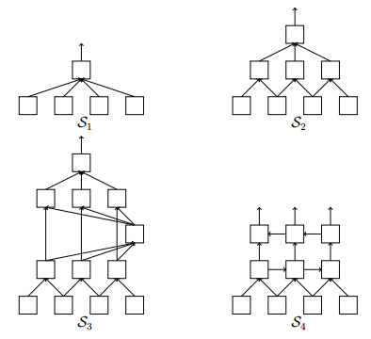
NN Review - Defining NNs
NNs are simplified models of neural processing in the brain
Neural Networks are a black box function
Neural Nets defined by three parameters:
The network structure

Slide 14
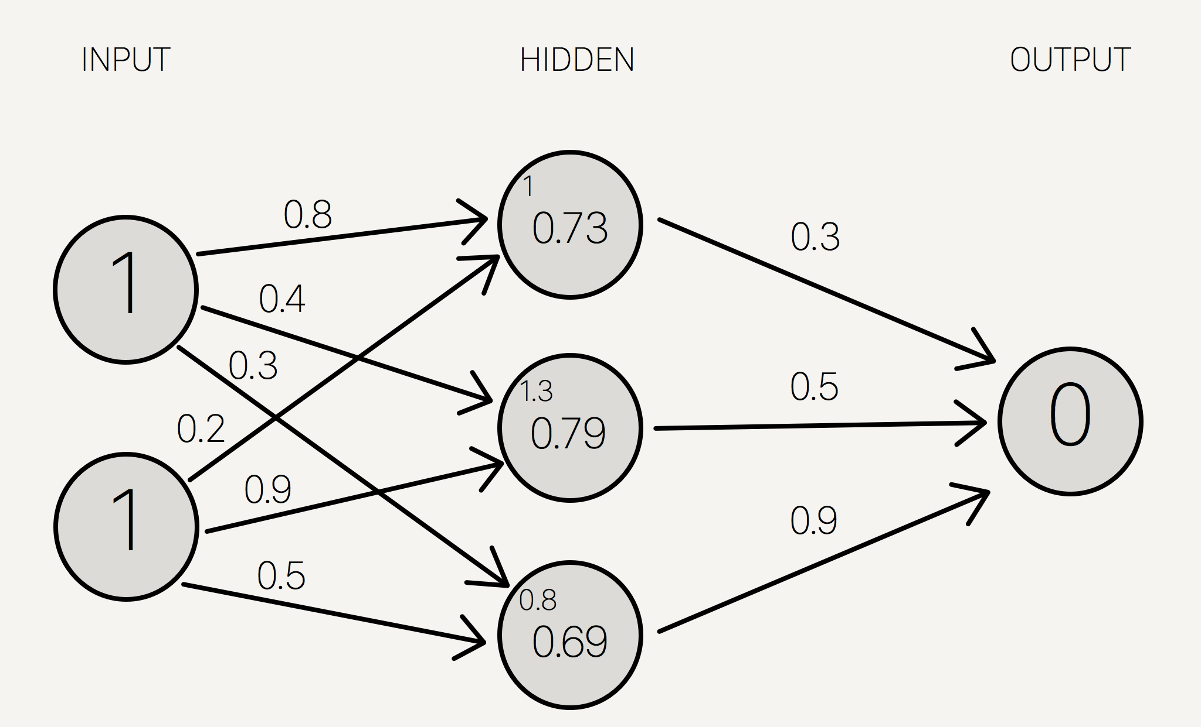
NN Review - Defining NNs
NNs are simplified models of neural processing in the brain
Neural Networks are a black box function
NNs defined by 3 params:
The network structure
Connection weights

Slide 15
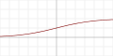

NN Review - Defining NNs
NNs are simplified models of neural processing in the brain
Neural Networks are a black box function
Neural Nets defined by three parameters:
The network structure
Connection weights
Activation functions of hidden layers
Sigmoid
ReLU

Slide 16
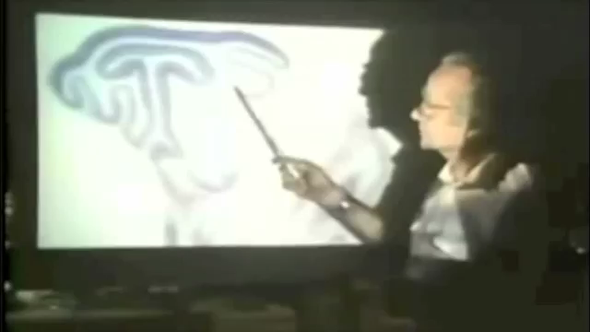
NN Review - A biological Foundation
Found that Neurons for vision operate as edge detectors

Slide 17
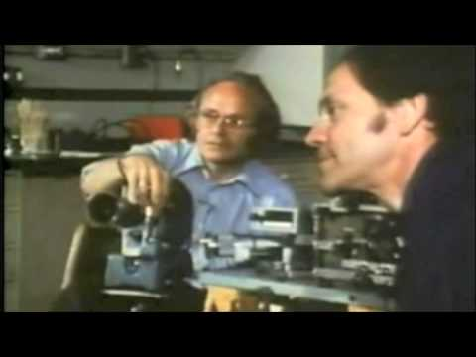
NN Review - A biological Foundation
CV researchers recreated these edge detectors on a computer from empirical data

Slide 18
NN Review - A biological Foundation
Hand crafting vision filters is not scalable
Backprop introduced to perform gradient optimization
Allows for efficient learning

Slide 19
Neural Networks Review
Layers that combine previous features to form new features
Each layer applies linear transformation, “weighing” previous features
Nonlinear activation function
Learns through gradient descent and backpropagation
BACKPROPAGATE
FEEDFORWARD

Slide 20
Convolutional Neural Networks

Slide 21
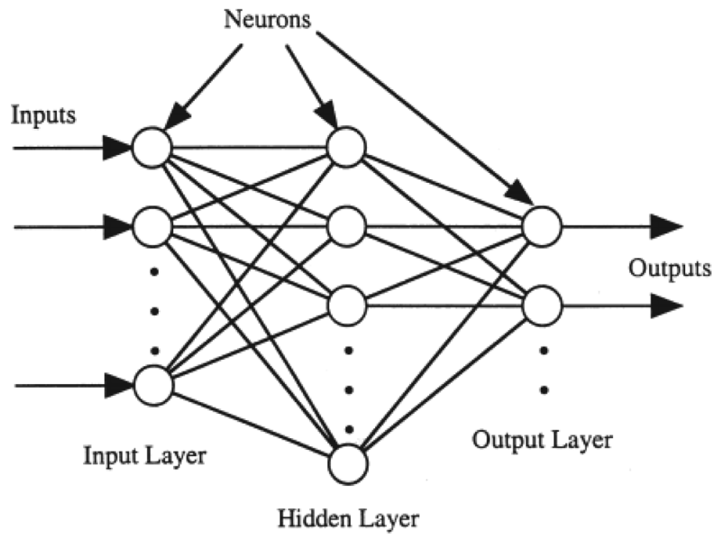

MNIST and Fully-connected
784 * 800 + 800 * 10 =
635,000 weights
784 800 10
(28px)² = 784-d vector

Slide 22


Images and FC Networks
(300px)² =
90,000 dimensional vector!
Min.
8 billion weights!
Notes:
Now let’s say we want to make a network that distinguishes between dogs and cats in a photo.
To make things a little easier, we add a preprocessing step to all our photos that makes sure our images are 300x300 in size.
This introduces a complication. We’ll first vectorize our image like we vectorized MNIST, yielding a 90,000 dim vector.
Then we’d need at least one hidden layer to do this operation!
Now in the last example we used a hidden layer of greater or equal size to the input.
This seems to increase the accuracy of the network.
If we did something similar in this case we’d have to deal with 8 billion weights! That would mean lowerbound the operation would take 3-4 seconds on a modern laptop, and likely require more time. Even then, we’d still probably need more hidden layers to actually compute anything relevant.
Clearly this is extremely limiting

Slide 23
Spatial information loss
Help!
Where am I?

Slide 24
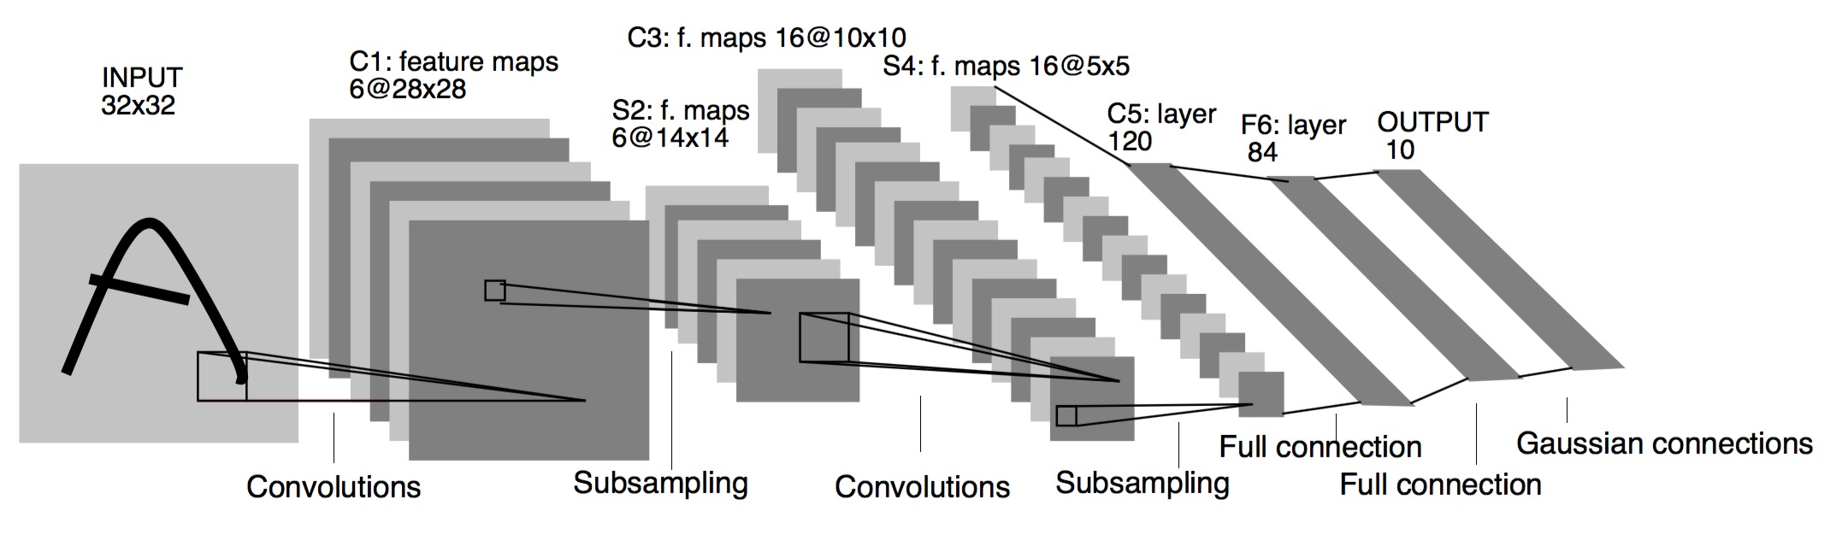
Convolutional NNs

Slide 25

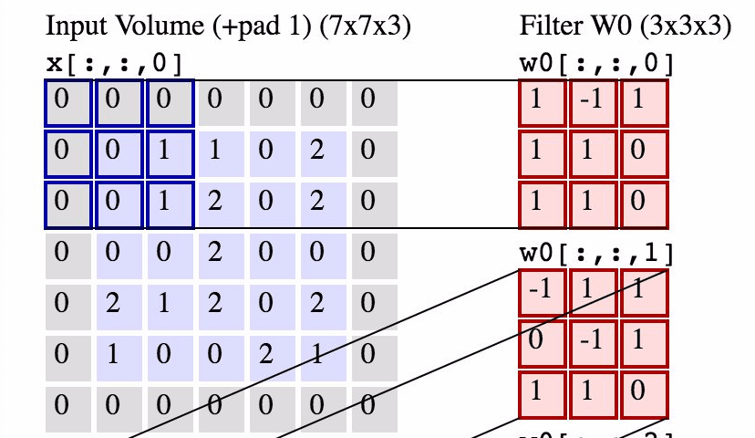
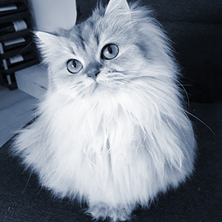

Convolution
Conv Layer

Slide 26
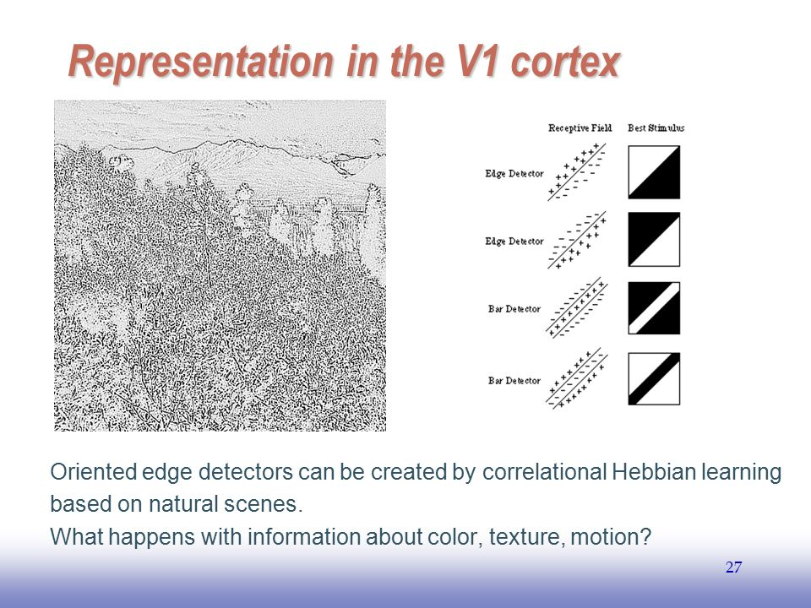
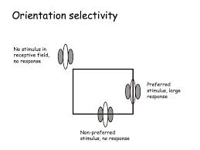
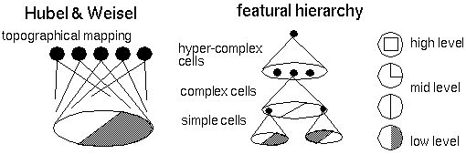
Biological Foundations

Slide 27
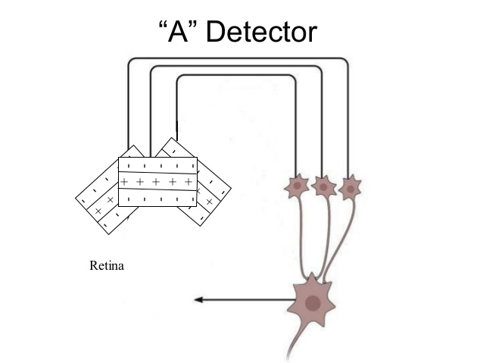
Biological Foundations

Slide 28
Tensorflow Introduction

Slide 29
Autodiff
Complexity of NN graph → infeasible to formulate gradients
Backpropagation leverages chain rule to compute gradient updates
Autodiff combines computational graph structure of NNs with chain rule

Slide 30
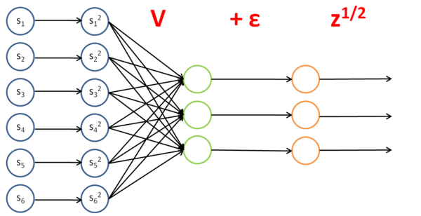
Autodiff
We want to train Node X
X

Slide 31
Autodiff
We want to train Node X
Define gradient w.r.t. It’s output
X

Slide 32
Autodiff
We want to train Node X
Define gradient w.r.t. It’s output
Defining gradients for each node in the graph lets us compute gradients for whole graph
X

Slide 33
Autodiff - Summary
Framework to leverage chain rule, and computational graph structure, to perform backpropagation

Slide 34

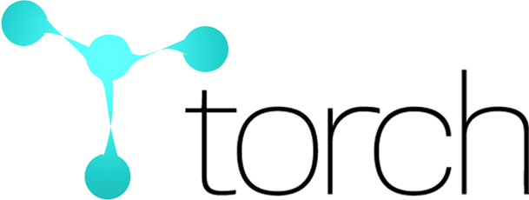


Neural Network Libraries
Pros:
- Strength in CNNs
- Image processing
- Python interface
Cons:
- Inflexible
- C++
Pros:
- Widely used
- High performance
- Python
Cons:
- Somewhat bulky
- Slow compile time
- Can get low-level
Pros:
- Slimmer
- High performance
- Modular
Cons:
- Academic use
- Lua (New pyTorch)
Pros:
- Gaining support
- TensorBoard
- Python
- Flexibility
- Google quality
Cons:
- slower than Torch

Slide 35
Why Learn TensorFlow?
Backed by Google
Constant development and frequent updates
DeepMind moving from Torch to TensorFlow
Several high level APIs
Growing Community (HYPE!!!)
Amount of example code and tutorials growing
Most commonly mentioned ML library on Stack Overflow
Long term support
Recent TensorFlow 1.0 update, all code will be compatible with 1.x updates

Slide 36
Tensorflow Basics

Slide 37
Tensors
Programmers: Tensors generalize multidimensional arrays.
Mathematicians: Generalize scalars, vectors, matrices and linear operators!

Slide 38
Tensors
Scalars are (0,0)-tensors, vectors are (1,0)-tensors, etc.
Ops are tensors: inner product is (0,2)-tensor
Tensors can describe a host of mathematical structures and operations, many of which are used in neural network computation

Slide 39
Tensors
Tensorflow describes data as Tensors
Library tries to push as much data through the computational graph, maximizing flow, hence the name TensorFlow

Slide 40
Computation Graph
Where all variables and operations for an NN live
Can define and use multiple graphs at once
Most applications just use a single default graph

Slide 41
Computation Graph
Workflow split into two parts: construction and execution

Slide 42
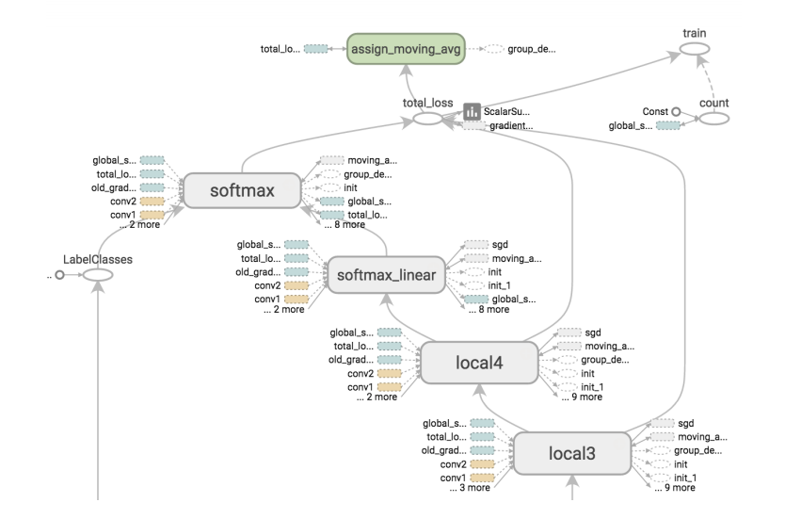
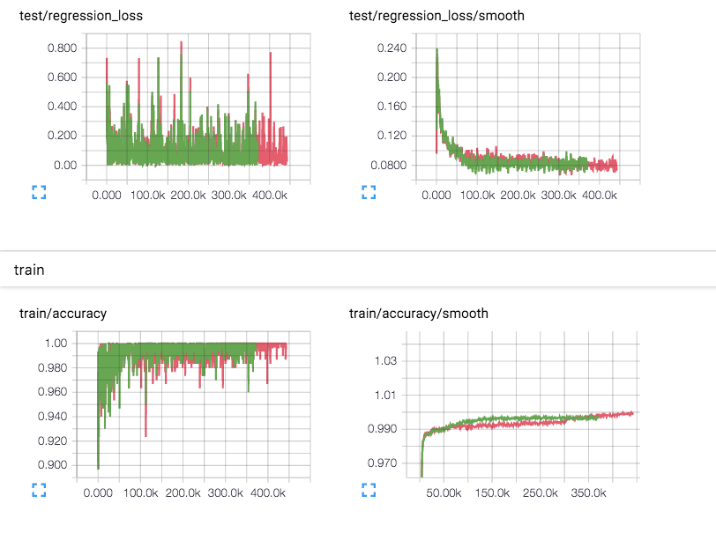
Computation Graph
Construction
Execution

Slide 43
Computation Graph
Workflow split into two parts: construction and execution
Construction: graph variables are created and linked
Execution: Forward and Backpropagation are run in Sessions

Slide 44
Variables
Stores parameters in the graph
Can be trainable (optimized during backprop) or untrainable
Variety of initialization methods (e.g. constant, random, etc.)

Slide 45
Operations
Takes in variables and/or outputs from other operations
Can be fed into other ops and linked into the graph

Slide 46
Variables+Ops
tf.random_normal
(mean=1, stddev=2)
tf.constant(3.0)
tf.mul()
tf.add()
tf.constant(5.0)

Slide 47
Sessions
Initialize, run operations, etc. on the graph
Handles all interactions with the graph after construction
Handles communication between devices (e.g. cpu->gpu)
Call the session’s run method to execute an op, and the series of ops connecting to it

Slide 48
Sessions
sess = tf.Session()
sess.run(tf.global_variables_initializer())
sess.run(mult_op)
1.68
3.0
tf.random_normal
(mean=1, stddev=2)
tf.constant(3.0)
13.44
8.0
tf.mul()
5.0
tf.add()
tf.constant(5.0)
mult_op

Slide 49
Computational Graph Demo
sess = tf.Session()
sess.run(tf.global_variables_initializer())
sess.run(mult_op)
1.68
3.0
tf.random_normal
(mean=1, stddev=2)
tf.constant(3.0)
13.44
8.0
tf.mul()
5.0
tf.add()
tf.constant(5.0)
mult_op

Slide 50
Building and Training Neural Networks

Slide 51
Optimizers
In order to train network, we need some method of optimization
Optimization/training methods located in tf.train

Slide 52
Optimizers
tf.train.GradientDescentOptimizer
tf.train.AdamOptimizer
tf.train.RMSPropOptimizer
etc.

Slide 53
Optimizers
Can add decay to optimizer
Tf.train.exponential_decay
global_step

Slide 54
Saving training process
tf.train.Saver
Saver.save
global_step
Saver.restore
tf.train.latest_checkpoint

Slide 55
Optimizers and Gradients
Optimizers have three functions:
Compute_gradients
Apply_gradients
Minimize
Wrapper that combines previous two

Slide 56
Optimizers and Gradients
Typically will just use minimize function for convenience
Use other two for fine-grain control of gradients
Quantization
Important for deploying NNs on phones/FPGAs
Important for adversarial sampling/defense
Gradient clipping
Important for training deep NNs/RNNs
Examples to come

Slide 57
Cost Functions
Tensorflow and high level APIs have predefined functions
Cost functions are ops (operations not optimizers)
Allows us to easily define our own
Feed cost function into optimizer
Optimizer will handle gradient computation

Slide 58
Placeholders
Entry point into the graph
Values filled/passed during session.run via feed dictionary
Can fill with default values tf.placeholder_with_default
E.g. sess.run(op,feed_dict={placeholder1:1.0,placeholder2:2.0})

Slide 59
High Level APIs
TF-Slim
Keras
Sonnet

Slide 60
High Level APIs
TF-Slim
Native tensorflow
Common combinations of ops

Slide 61
High Level APIs
Keras
Rapid Prototyping
Abstracts process of defining variable shapes
Built in cost functions, metrics, datasets, etc.
Officially declared as Tensorflow’s high level API
Python
Great for Convolutional NNs
Abstracts away shape calculation

Slide 62
High Level APIs
Sonnet
Google Deepmind’s own DL development API
Object oriented
Clean, prod-quality DL-models
Powerful weight sharing capabilities
Beneficial for deploying large, complex, general DL systems
Re-usability

Slide 63
Keras Demo: Building a 2-layer NN

Slide 64
Demo: Building a 2-layer NN
Native TF

Slide 65
Visualizing NNs

Slide 66
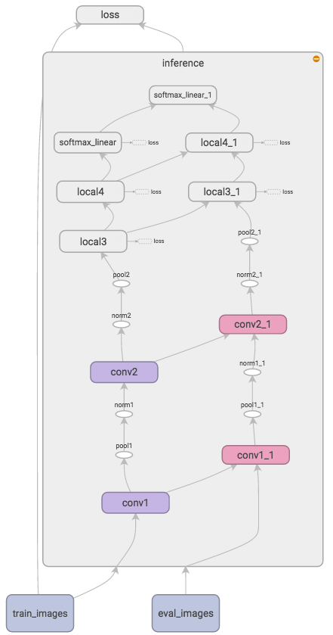
TensorBoard
Graph Visualization
See visual representation of the graph
Check and debug construction
Scoping
Used to create abstractions
Without scoping, graph can become a convoluted mess
Created by using a with statement
Scope gets name prepended to variable and operation names
Sonnet helps

Slide 67
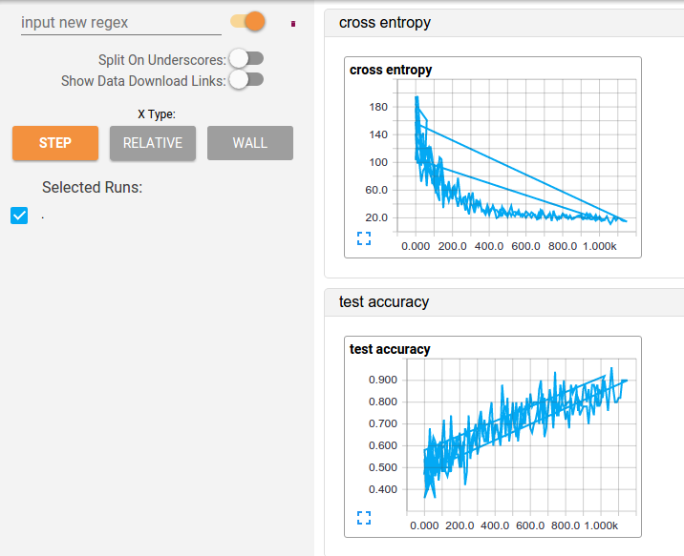
TensorBoard
Visualizing Learning
See tensor values during training
Check and debug execution
tf.train.SummaryWriter()

Slide 68
Demo: Visualizing NNs

Slide 69
RNNs

Slide 70
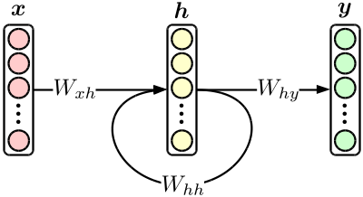
Introducing the RNN/LSTM
RNNs/LSTMs

Slide 71
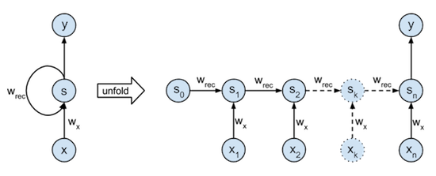
Introducing the RNN/LSTM

Slide 72
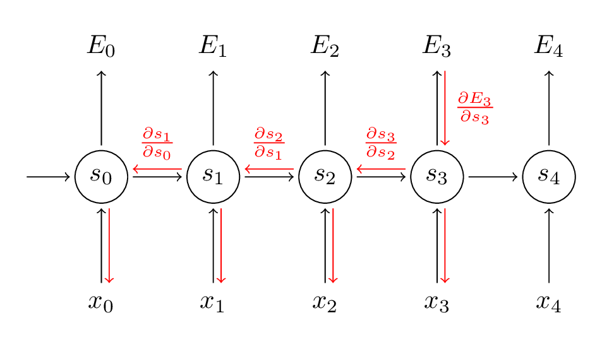
Gradient Explosion
s is LSTM state
Multiplicative Chain Rule
Gradient compounds
“Explodes”

Slide 73
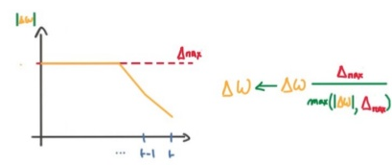
Gradient Quantization/Clipping
Clip Gradients to some value
Take signs of gradients
-1,0,1
Gradient quantization

Slide 74
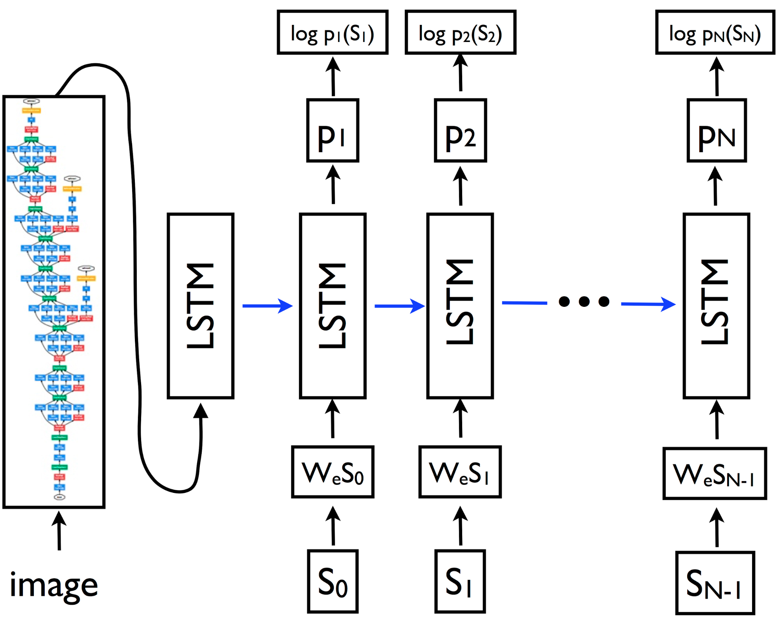
Embedding Spaces

Slide 75
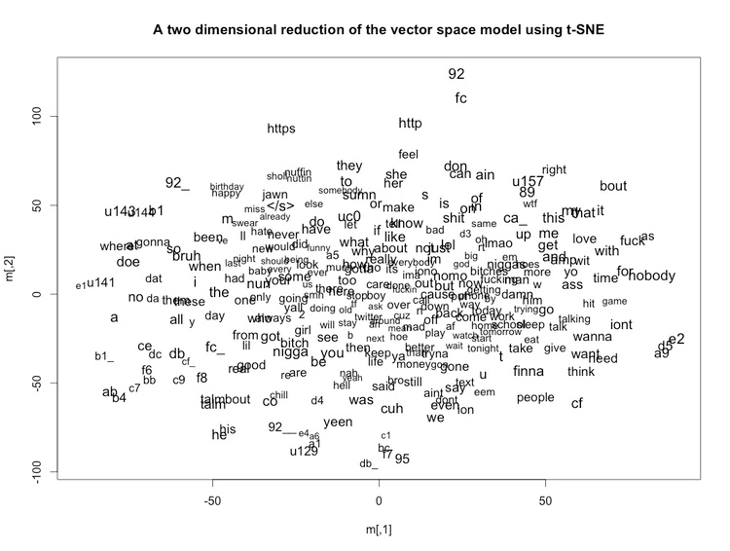
Embedding Spaces
Learned continuous representation of dimension d
d=2 here
Linear Transformation from n -> d dimensions

Slide 76
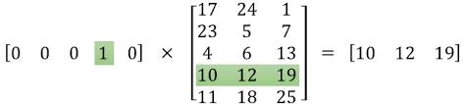
Embedding Spaces
One-hot encoding is a sparse vector
Linear Transformation embedding acts as lookup table for d-dimensional representations of words

Slide 77
Embedding Spaces
One-hot encoding is a sparse vector
Linear Transformation embedding acts as lookup table for d-dimensional representations of words
How do we leverage this in TF?

Slide 78
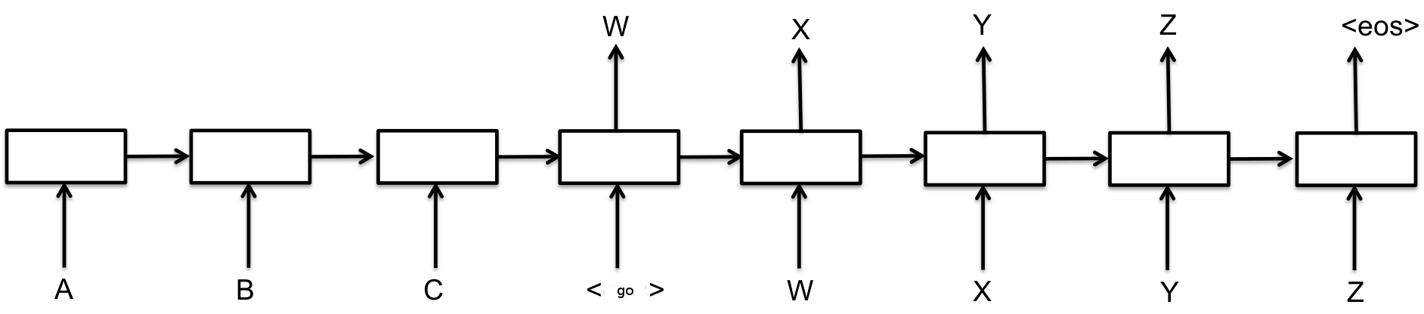
LSTMs: Seq2Seq
Generative RNNs as a decoder module
Sequential nature makes it impossible to preprocess decoder RNN inputs
Can’t flatten inputs and unilaterally transform input
tf.nn.seq2seq module

Slide 79
LSTMs: Seq2Seq
Our encoder module: VGG16
Our decoder module: Caption Generator

Slide 80
Demo: Building a Caption Generator

Slide 81
Large-Scale TF Variable Sharing

Slide 82
Variable Sharing w/ Sonnet
In advanced DL systems (such as in Google Deepmind’s work) variable sharing is frequently utilized
Transfer Learning, EWC, Pathnet, etc.
Easily done in Torch since functions that make ops are instantiated as objects
Deepmind transitioned Torch→TF
wanted similar functionality
Sonnet API
Clean DL dev w/ variable scopes
Modularity
Code reuse

Slide 83
Variable Sharing Use Case
Consider case where we want to classify or caption an image
We want to use same conv-net for both tasks
Define both in separate graphs/namespaces
(we could just put them in one, but this would result in slower computation of both tasks)
Getting variable names correct will be difficult

Slide 84
Demo: Sonnet

Slide 85
Variational Autoencoders

Slide 86
Seq2Seq Autoencoder

Slide 87
Seq2Seq Autoencoder
Deterministic/memorize train set
Generated seq is dependant on middle state
Loss of information

Slide 88
Seq2Seq VAE
Variational Autoencoder
Unsupervised learning
Output unit gaussian distribution parameters instead of vector

Slide 89
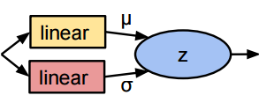
Seq2Seq VAE
Seq2Seq = 1 RNN
VAE= Encoder+Decoder RNN
Talk to me after if interested in learning about multiagent learning

Slide 90
Seq2Seq VAE
Formulate loss penalty to constrain mean and std to be unit gaussian

Slide 91
Demo: VAE

Slide 92
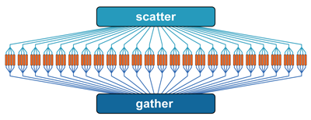
Tensorflow Indexing
tf.gather_nd
tf.scatter_nd

Slide 93
Demo: VAE

Slide 94
Deploying TF Models in your app

Slide 95
Demo: Flask Prototyping

Slide 96
Variable Sharing+Transfer
Transfer Learning requires use of already trained graph
We can restore variables
Requires us to code graph
Import input and output nodes to transfered graph
tf.import_graph_def

Slide 97
Demo: Flask Prototyping
Flask pros:
Easy to integrate with workflow.
lightweight
Docker containers
Rapid prototyping
Flask drawbacks:
Rigid
Slow
Does not leverage TF’s flexibility
TF designed to run anywhere and any platform

Slide 98
Running a TF model
Building TF model (with or w/o bazel)
Running C++ server
TF datastreaming (FIFOQueue’s)
Protobuf Serialization

Slide 99
Protobuf Serialization
Google’s data serialization format, used in several Autodif library
.pb file
Define a struct in C-esque format
Wrap in python or language of your choice
Tensorflow flexibility
TF_Example format

Slide 100
Model Export Walkthrough
TF Original

Slide 101
Scalable Model Training

Slide 102
Model vs. Data Parallelism
Model Parallelism:
Create large model and distribute computation over multiple GPUs
Data Parallelism:
Create several instances of the same model and train them in parallel data batches

Slide 103
Model vs. Data Parallelism
Model Parallelism:
Create large model and distribute computation over multiple GPUs
Data Parallelism:
Create several instances of the same model and train them in parallel data batches

Slide 104
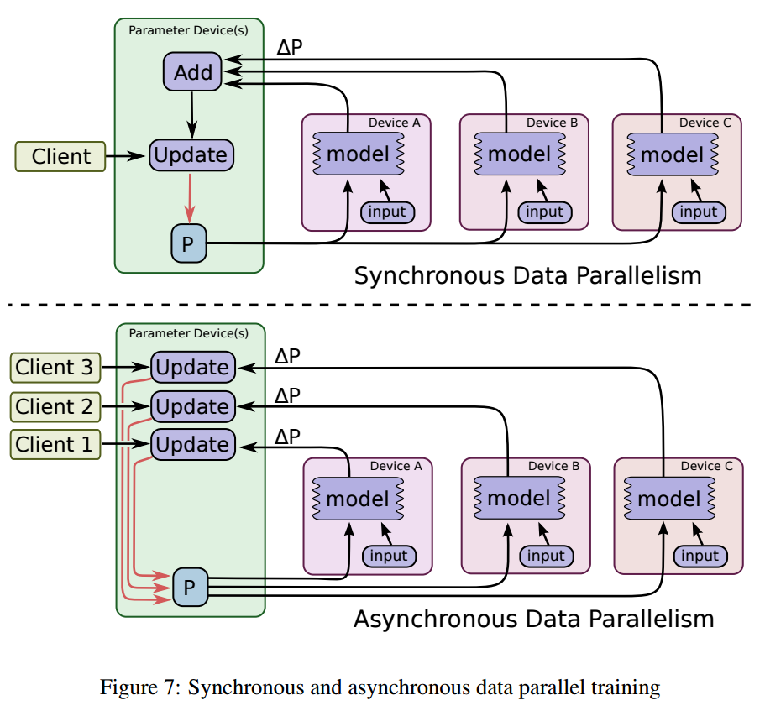
Data Parallelism

Slide 105
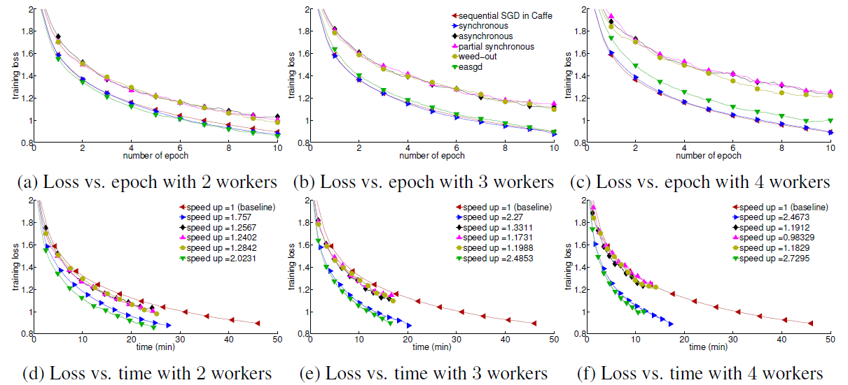
Benefits of Data Parallelism

Slide 106
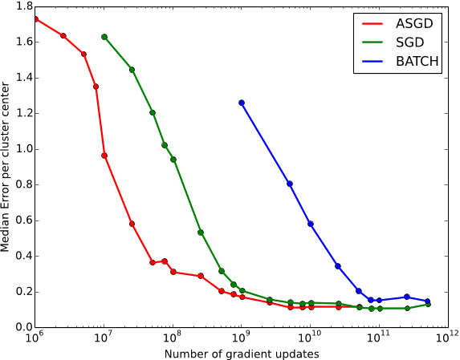
Benefits of Data Parallelism

Slide 107
Multi-GPU walkthrough

Slide 108
Conclusion

Slide 109
About me
Machine Learning at Berkeley (ML@B)
ml.berkeley.edu
LinkedIn
raulpuric@berkeley.edu

Slide 110
Q&A

